Slide 1
Identifying and Estimating Glacial Lake Area from Satellite Imagery
Lakshmipriya Anil

Slide 2

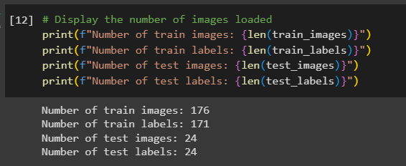
Dataset
GLACIAL LAKES DETECTION DATASET -
True Colour Composite Images of High-Mountains Asia (HMA )
Abdul Basit, Muhammad Adnan Siddique, July 4, 2022, "Glacial Lakes Detection Dataset", IEEE Dataport, doi: https://dx.doi.org/10.21227/th0c-8t68.

Slide 3
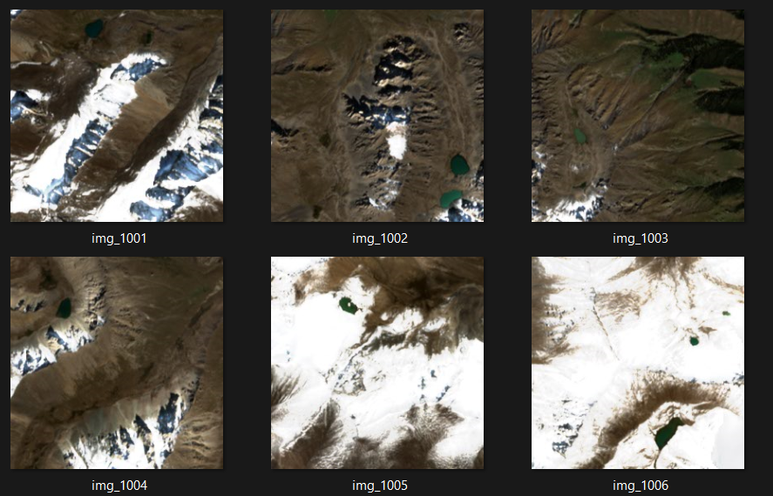
Training Image Data

Slide 4
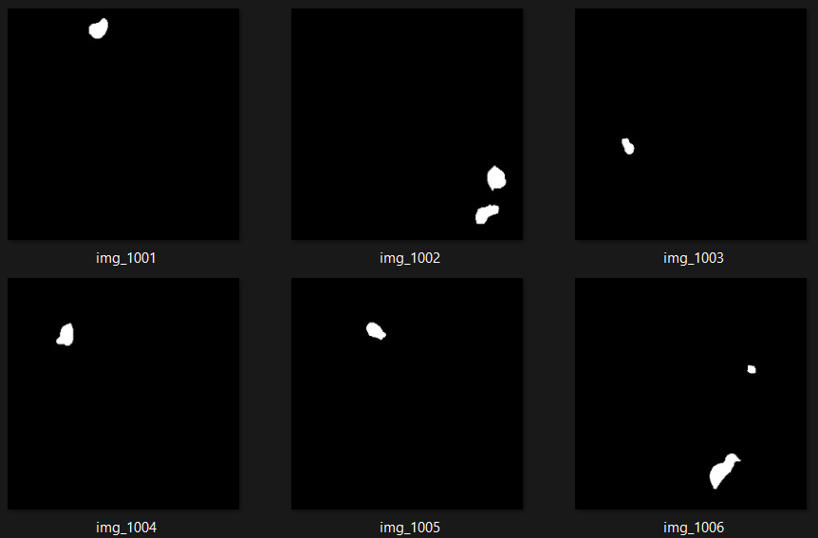
Training Image Labels

Slide 5
Image Pre-processing

Slide 6
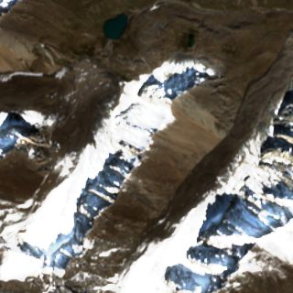
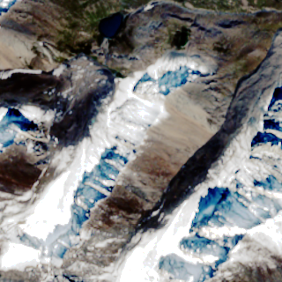
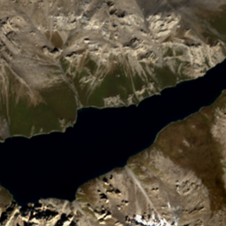
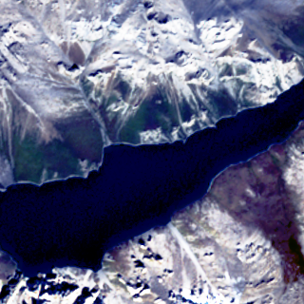
Histogram Equalization

Slide 7
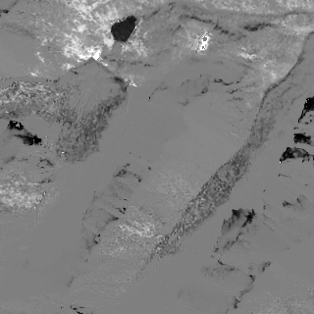
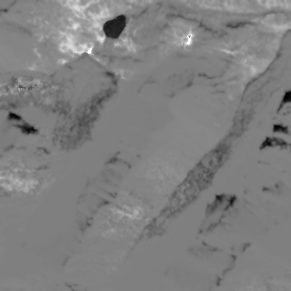
Normalized Difference Water Index

Slide 8
Feature Extraction

Slide 9
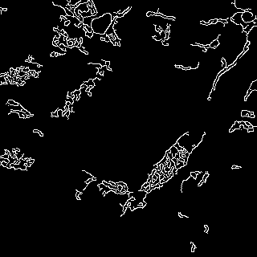
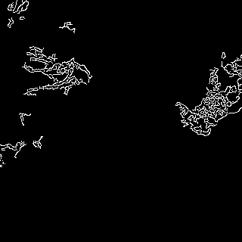
Canny Edge Detection Method

Slide 10
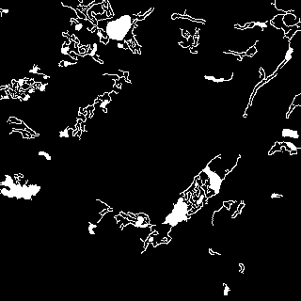
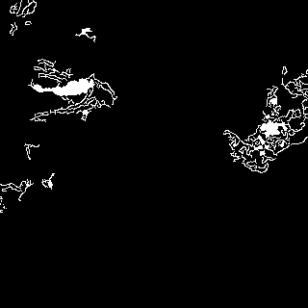
Contour Identification

Slide 11
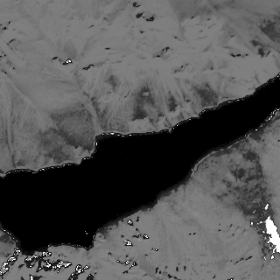
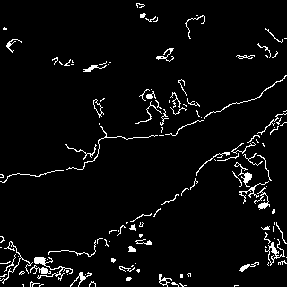
Contour Identification

Slide 12
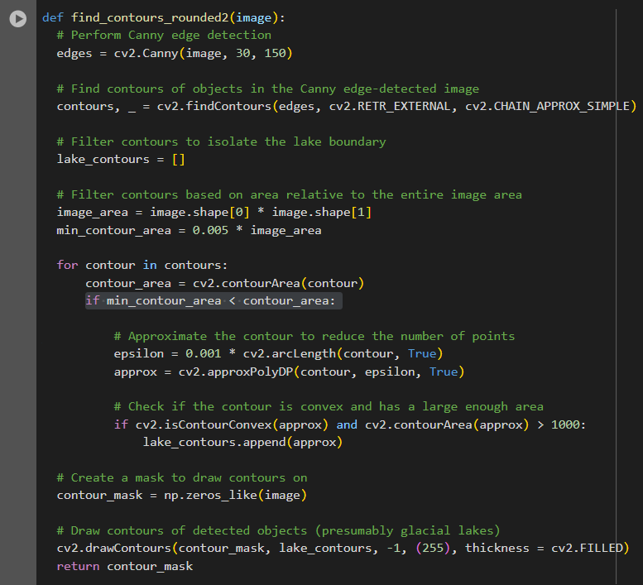
Contour Filtering

Slide 13
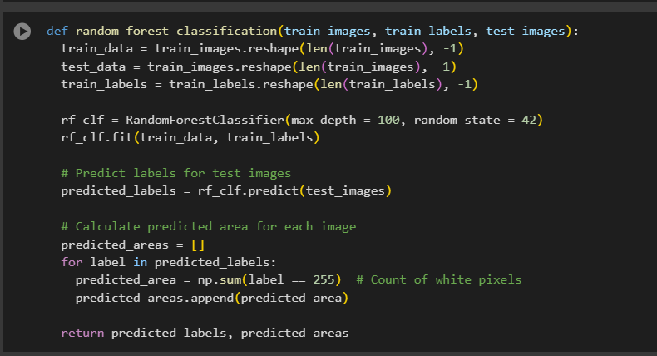
Random Forest Classification

Slide 14
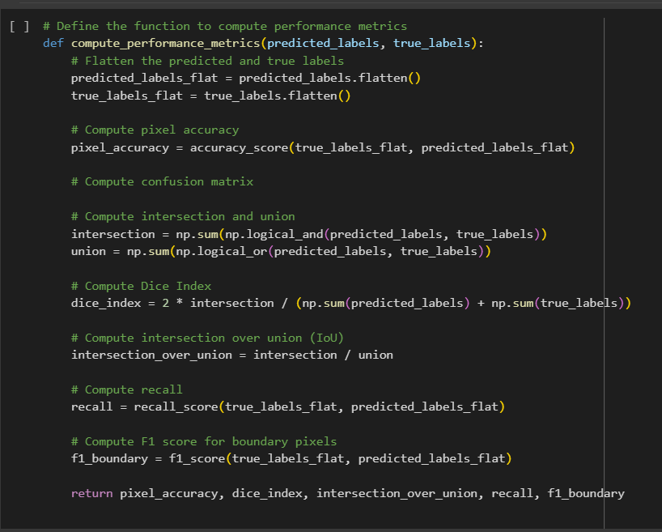
Performance Evaluation

Slide 15
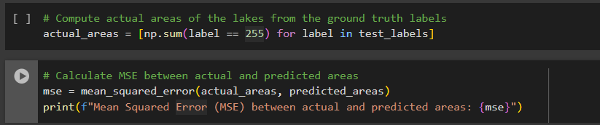
Performance Evaluation

Slide 16
FUTURE SCOPE

Slide 17
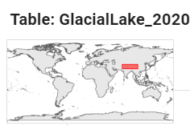
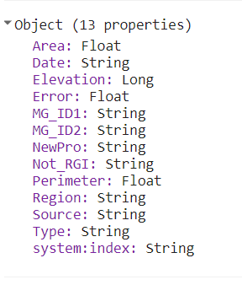
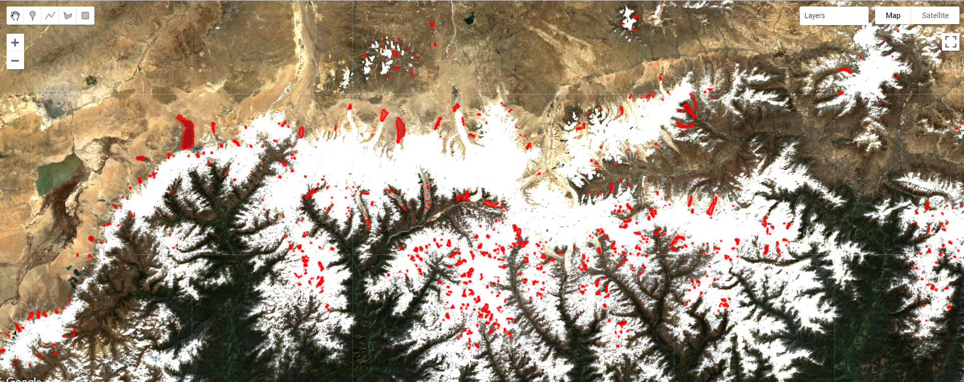
Dataset
Glacial lake inventory (1990, 2000, 2010, 2015, and 2020) in the greater Himalaya
Region: Hindu Kush, Karakoram, Western Himalaya, Central Himalaya, Eastern Himalaya, Nyainqêntanglha, Hengduan Shan
Zhang, Guoqing (2022). Glacial lake inventory (1990, 2000, 2010, 2015, and 2020) in the greater Himalaya. figshare. Dataset. https://doi.org/10.6084/m9.figshare.21708590.v1

Slide 18
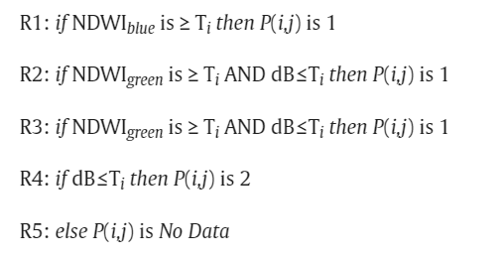
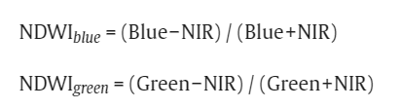
Semantic Segmentation using Expert System

Slide 19
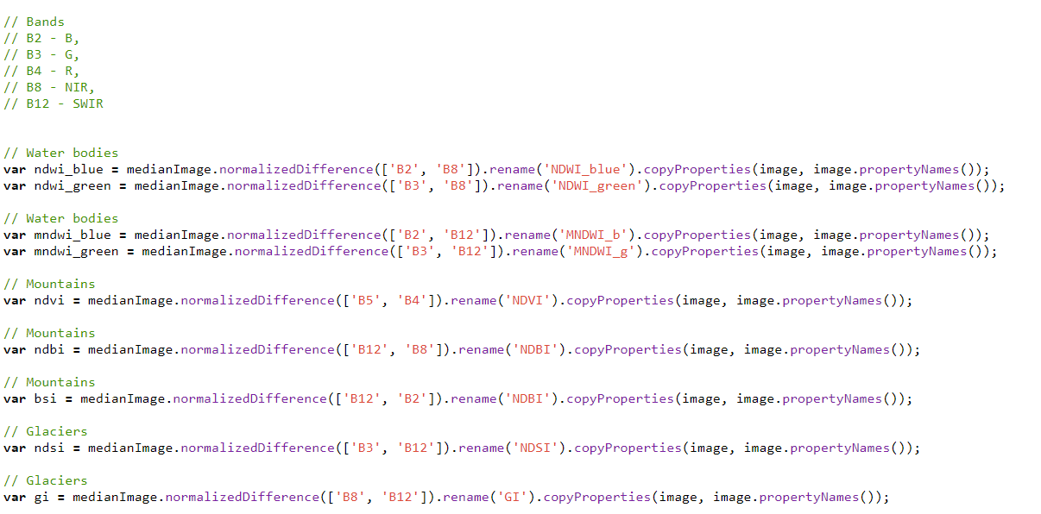

Slide 20
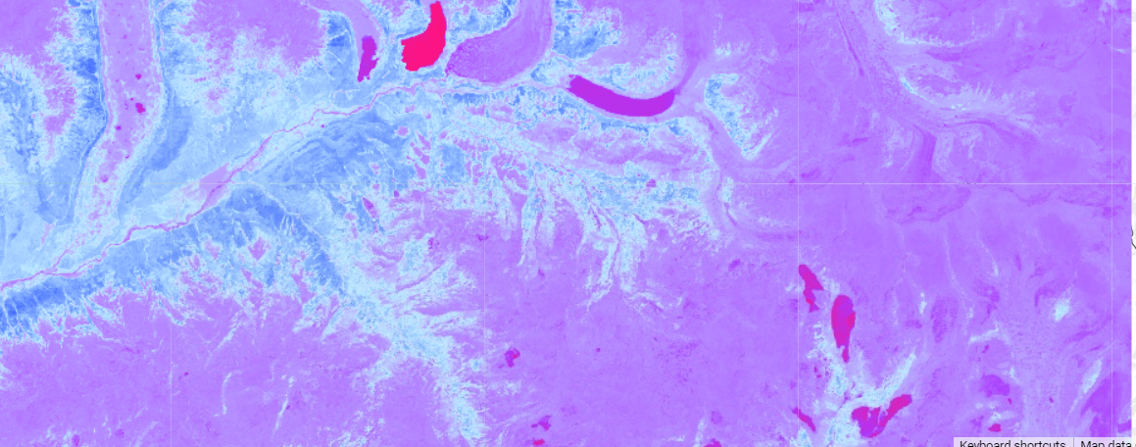
Pixel Based Image Analysis
NDWI_green

Slide 21
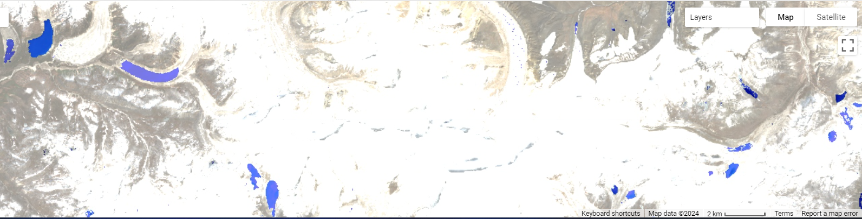
Pixel Based Image Analysis
NDWI_green > 0.3 (Rule - 3)

Slide 22
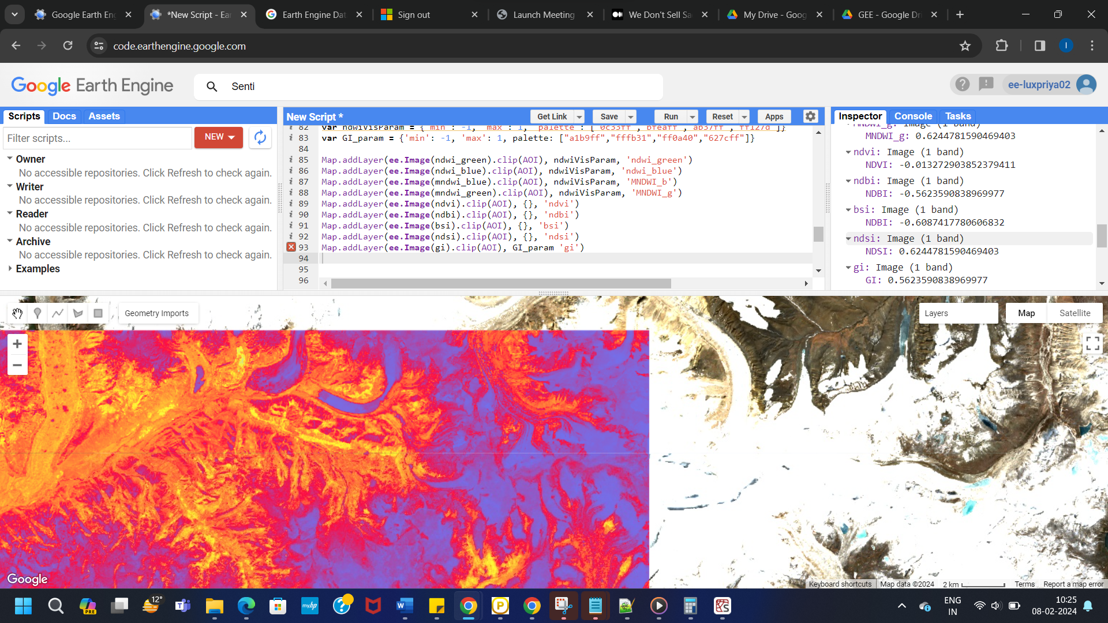

Pixel Based Image Analysis
NDGI

Slide 23
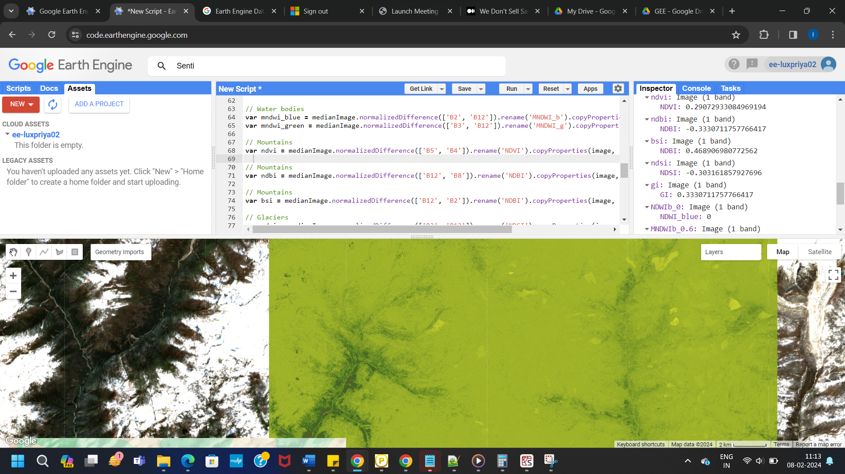
Pixel Based Image Analysis
NDVI

Slide 24
THANK YOU

